Slide 1
DERMATOPHYTOSIS
Challenges in the treatment and the novel solution

Slide 2
Dermatophytosis
Dermatophytosis is a term used to describe mycotic infections caused by a group of fungi that usually remain localized to the superficial layers of the skin, hair, or nails.
Dermatophytosis is also known as
About 40 types of fungus can cause ringworm. They are typically grouped into 3 types-
                Trichophyton
                Microsporum
                Epidermophyton
Ref:Havlickova B, Czaika VA, Friedrich M. Epidemiological trends in skin mycoses worldwideexternal icon. Mycoses. 2008 Sep;51 Suppl 4:2-15.

Slide 3
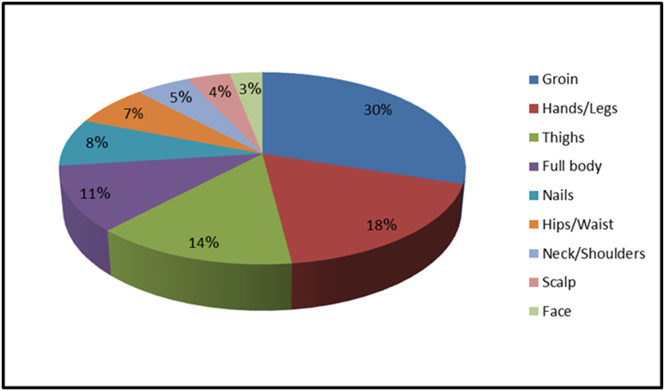
Types of Dermatophytosis
The different types of ringworm are usually named for the location of the infection on the body. Areas of the body that can be affected by ringworm include:
Type | Site
Tinea pedis | Feet
Tinea cruris | Groin, inner thighs, or buttocks
Tinea capitis | Scalp
Tinea barbae | Beard
Tinea manuum | Hands
Tinea unguium | Toenails or fingernails
Tinea corporis | Other parts of the body
Mohammed Hussein Mushrif. Common Diseases of Dermatophytic Infection and Sensitivity Determining of Diagnostic Procedures. American Journal of Medical Sciences and Medicine. 2016; 4(4):87-91. doi: 10.12691/ajmsm-4-4-4.

Slide 4
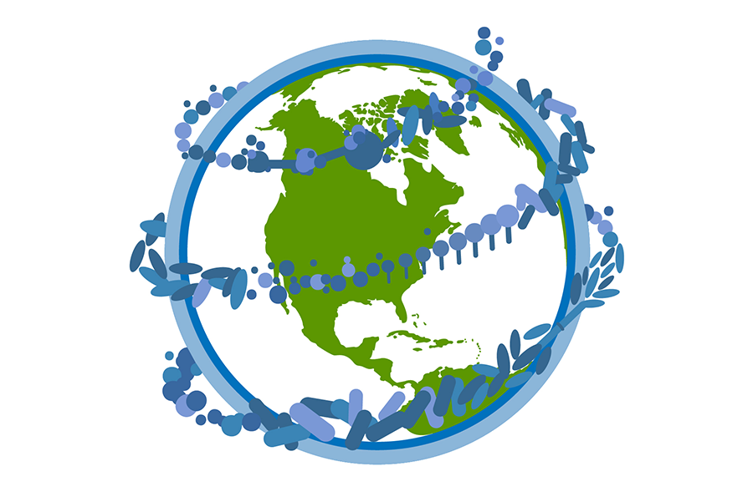

Epidemiology
Globally, approximately 20–25% of the population is affected by dermatophytosis.
61–67% patients with dermatophyte infections are from lower socioeconomic groups.
Ref: The unprecedented epidemic-like scenario of dermatophytosis in India: I. Epidemiology, risk factors and clinical features,Indian Journal of Dermatology, Venereology and Leprology @March, 2021,

Slide 5


Epidemiology
>60% patients suffer from Chronic dermatophytosis (disease for more than 6 months with or without recurrence despite being treated)
9-60% cases has the trend of recurrent and relapsing dermatophytosis.
Ref: The unprecedented epidemic-like scenario of dermatophytosis in India: I. Epidemiology, risk factors and clinical features,Indian Journal of Dermatology, Venereology and Leprology @March, 2021,

Slide 6
Causes of Rising Prevalence of Dermatophytosis
The current face of dermatophytosis has possibly been an outcome of a complex and intrigued interplay between host, fungus, drug and environment contributed by multiple factors like-
      More humid and warmer climate
      Irrational use of topical corticosteroid-based combinations and broad spectrum antibiotics.
      Increasing burden of immune-compromised population
      Widespread use of antifungals in the agricultural industry
      The questionable role of antifungal drug resistance
Ref-Expert Consensus on The Management of Dermatophytosis in India (ECTODERM India):Rajagopalan et al. BMC Dermatology (2018) 18:6

Slide 7
Mode of Transmission
Anthropophilic –transmitted human to human, e.g., T. verrucosum.
Zoophilic fungi- transmitted from animal to human (e.g., M. canis, T. verrucosum).
Geophilic- transmitted from soil to man (e.g., M. gypseum, T. ajelloi).

Slide 8
Clinical Manifestations Of Ringworm
The symptoms often depend on which part of the body is infected, but they generally include:
            Ring-shaped lesion
            Itchy skin
            Red, scaly, cracked skin
            Multifocal alopecia

Slide 9
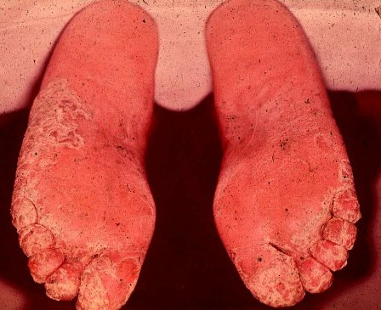
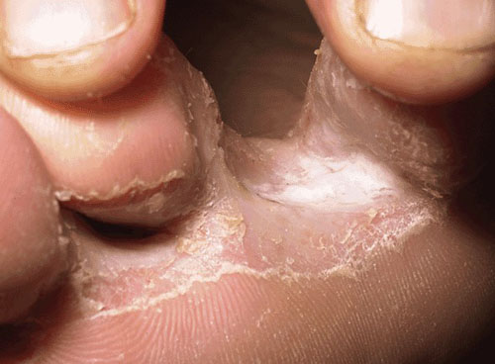
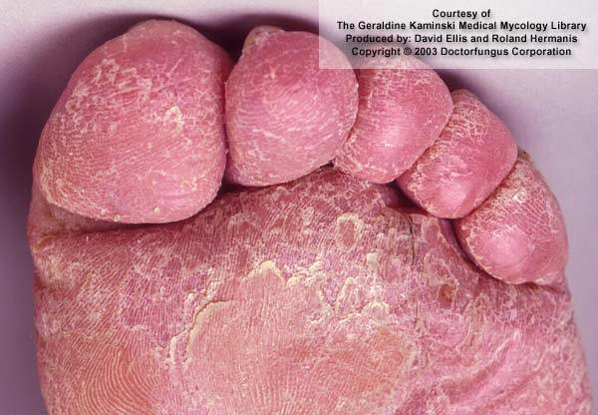
Tinea Pedis - Athletes’ Foot
Features-
Site- Between toes or toe webs (releasing of clear fluid) - 4th and 5th toes are most common.
Soreness and itching of any part of the foot.

Slide 10
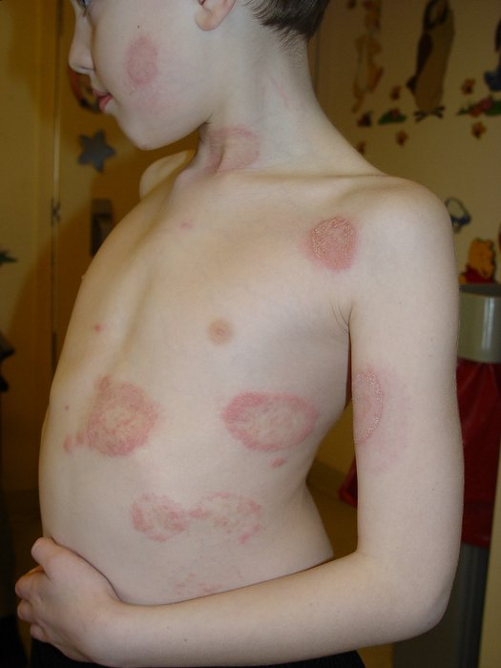
Tinea Corporis – Body ringworm
Generally restricted to stratum corneum of the smooth skin.
Produces concentric or ring-like lesions on skin
In severe cases –Lesions are raised and inflamed.
Normally resolves itself in several months.

Slide 11
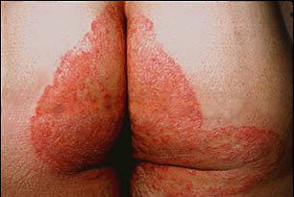
Tinea Cruris-Jock Itch
Infection seen on scrotum and inner thigh, the penis is usually not infected.
More common in men
Epidemics associated with grouping of people into tight quarters - athletic teams, troops, ship crews, inmates of institutions.

Slide 12
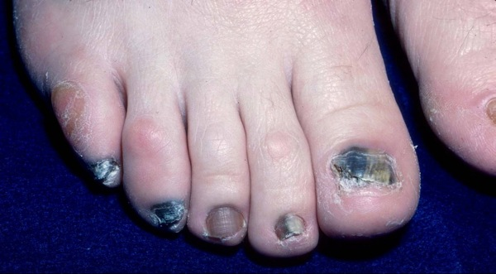
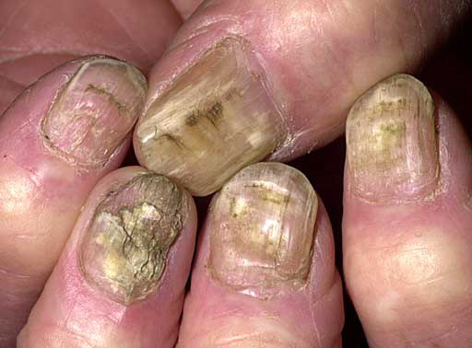
Tinea Unguium or Onychomycosis
Onychomycosis is a fungal infection of the nails that causes discoloration, thickening, and separation from the nail bed.
Resistant to treatment, rarely resolves spontaneously.

Slide 13
Tinea capitis
Tinea capitis is characterized by irregular or well-demarcated alopecia and scaling.
It can be Inflammatory/Non inflammatory.
Cervical and occipital lymphadenopathy may be prominent.
Inflammatory | Non inflammatory
Black dot Gray patch | Kerion Favus

Slide 14
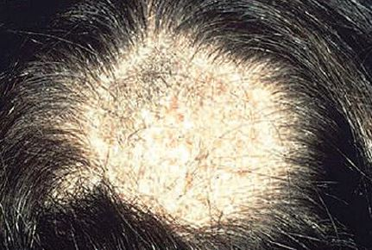
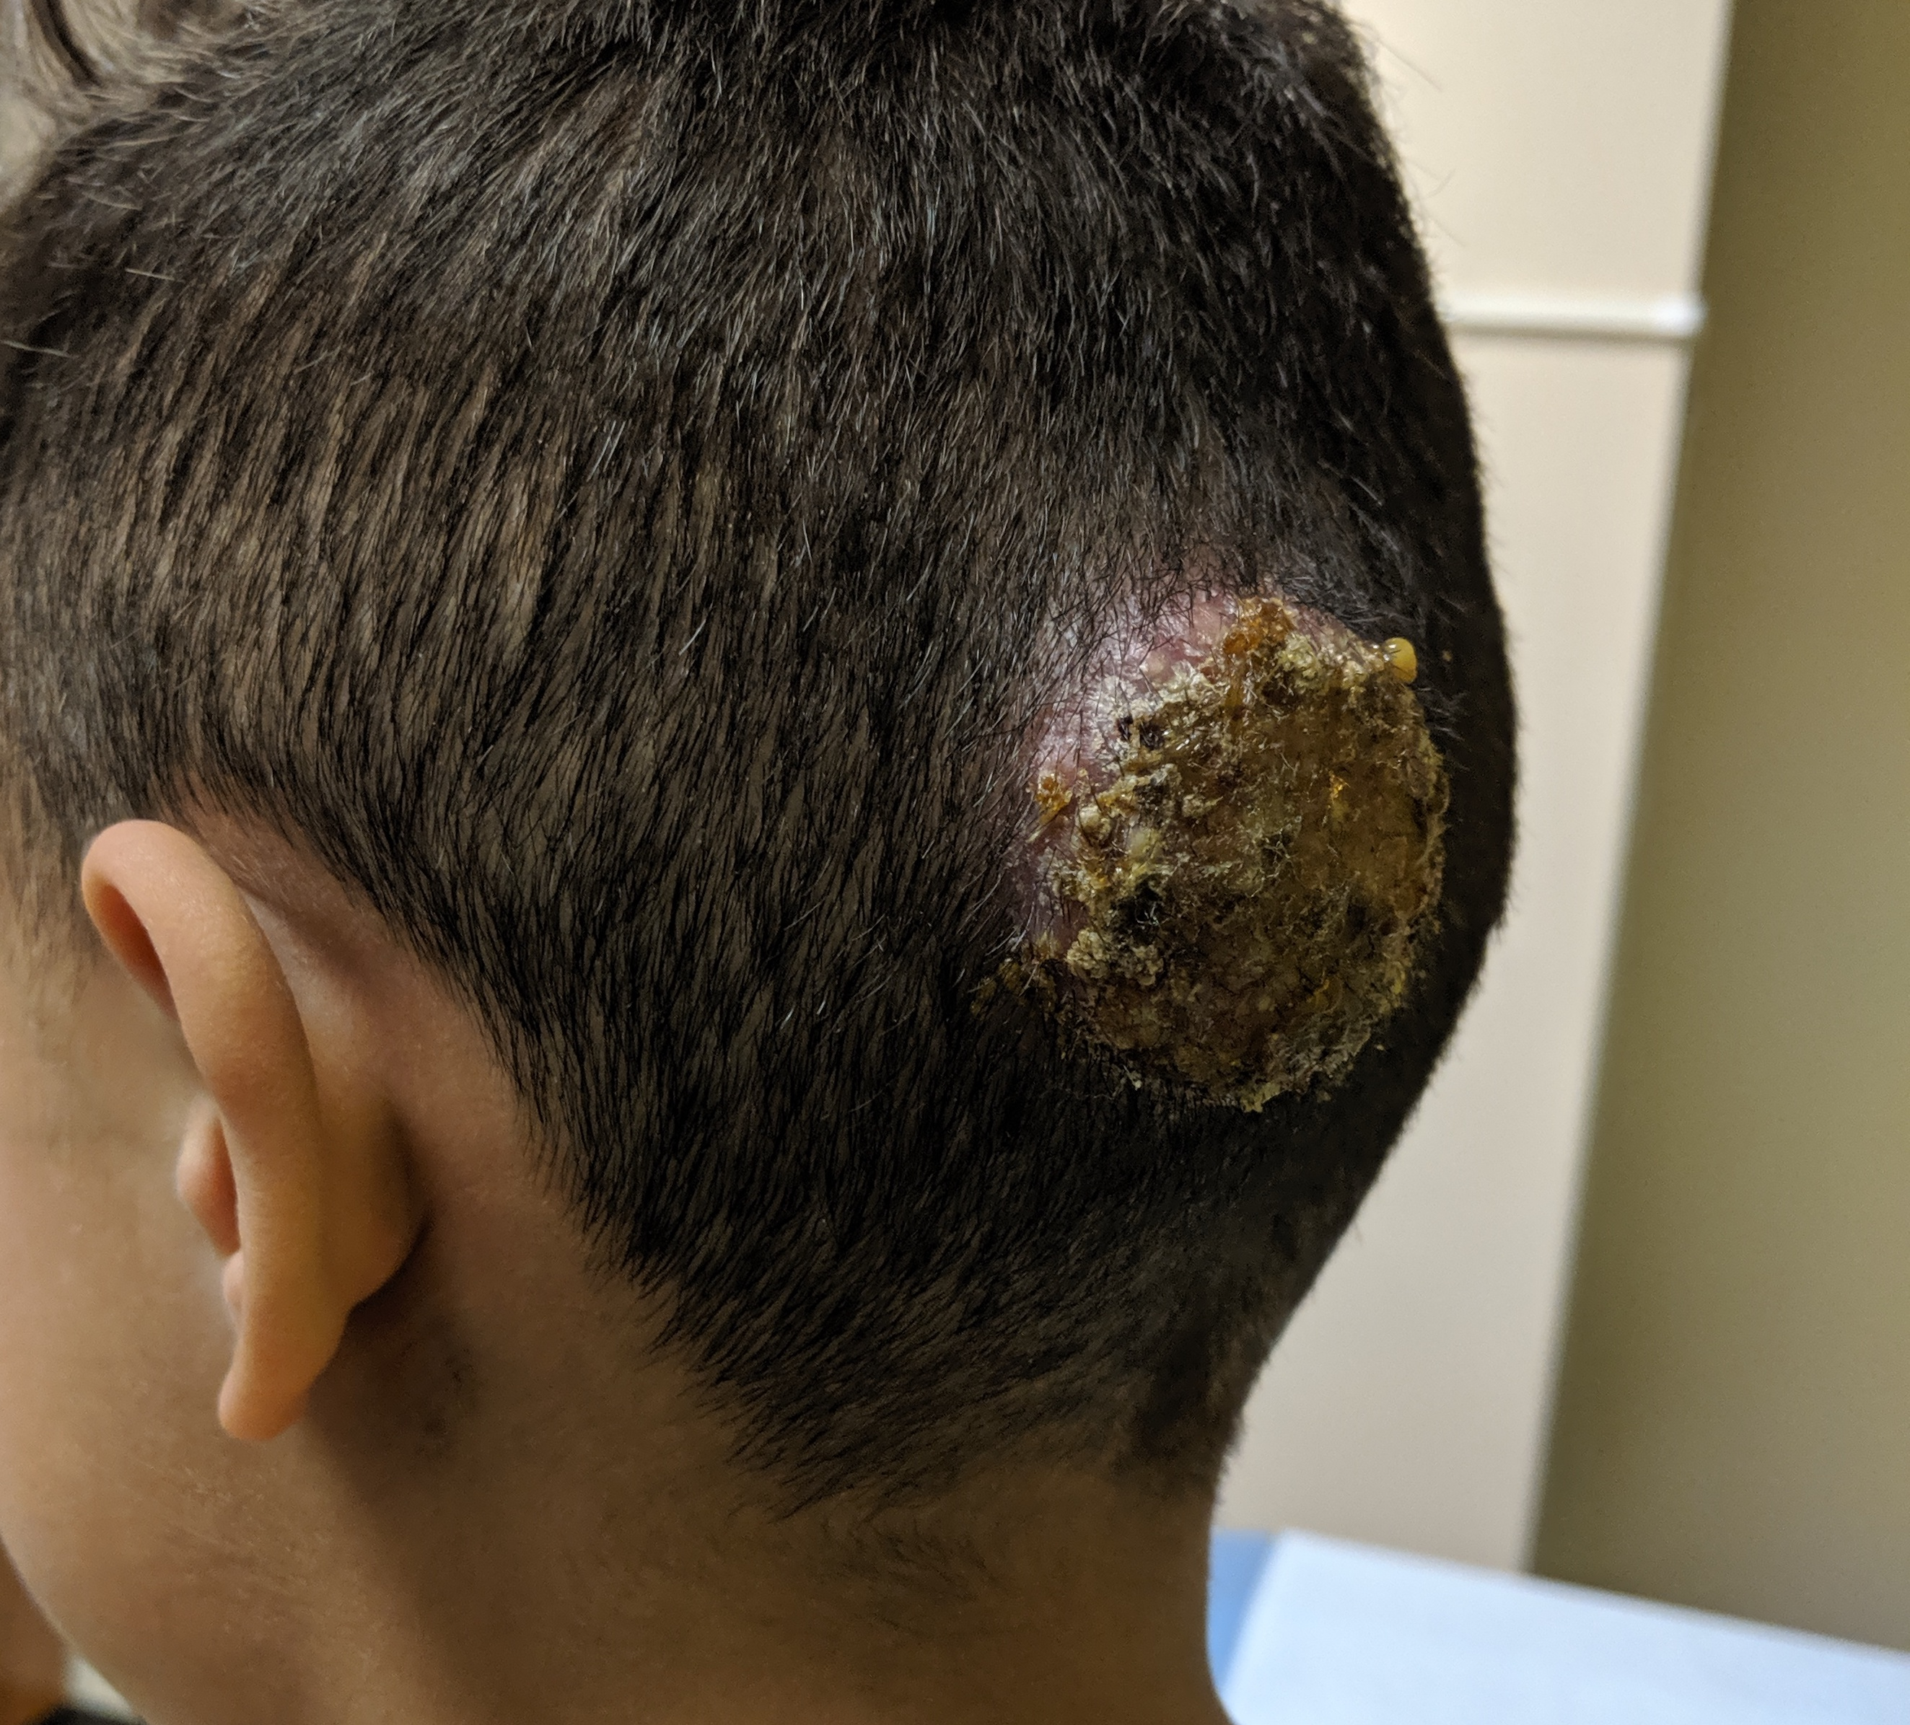
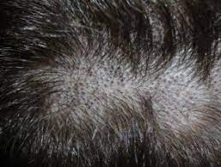
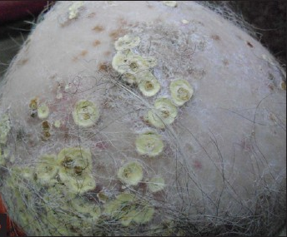
Gray patch
Kerion
Black dot
Favus

Slide 15
Diagnosis
Diagnosis mostly depends on clinical examination.
Confirmatory Laboratory investigations are-
        Nail clipping or SKIN SCRAPING TEST WITH 10% KOH- Skin scrapings should be collected from the edge of the lesions
        CULTURE- Sabouraud’s dextrose agar.
        Wood’s lamp test
K. Neena, Illustrated synopsis of Dermatology & Sexually Transmitted Diseases. 3rd Edition. New Delhi: Elsevier Health INR publication; 2012.

Slide 16
Differential daignosis
Allergic contact Dermatitis
Psoriasis
Eczema
Cutaneous candidiasis
Acanthosis nigricans

Slide 17
Treatment
Treatment options-
Azoles
    Clotrimazole
    Econazole
    Ketoconazole
    Miconazole
    Itraconazole
    Tioconazole
    Fluconazole
    Luliconazole.
Allylamines-Terbinafine
Griseofulvin
Effectiveness of dermatophytosis treatment depends on 3 factors-
Fungal Characteristics
Host immunity
Drug competency

Slide 18
Challenges in the treatment of dermatophytosis
Topical Antifungal Agent
Systemic antifungals
Most of the currently used antifungals requires prolonged treatment for complete clearance of the fungal elements.
patient nonadherence
        The high rate of relapse
        Antifungal resistance
Risk of hepatotoxicity
Possible drug-drug interactions with other systemic medications.

Slide 19
So, there is a substantial Unmet Need for an Ideal topical antifungal agent with……
Broad-spectrum activity
Low relapse rates
Broad-spectrum activity
Convenient dosing schedules
A reservoir effect in the stratum corneum
Efficacy at low concentrations
Lack of development of resistance
High mycologic and clinical cure rates
A low cost.

Slide 20
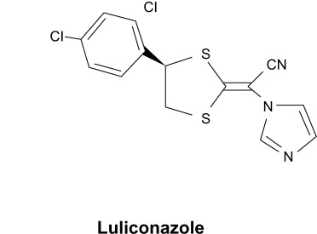
The Potent power Antifungal- Luliconazole
Luliconazole is The Potent power Antifungal because-
Unique ketene dithioacetate structure incorporated with imidazole moiety exerts strong fungicidal effect by weaking fungal cell wall
Has broad spectrum antifungal activity with lowest concentration
Less chance of recurrence of fungal infection
Patient compliance with convenient dosing schedules and cost.
Ref: Luliconazole for the treatment of fungal infections: an evidence-based review, Core Evidence 2014:9

Slide 21
Luliconazole is the antifungal with Superpower
Shorter duration of therapy
Excellent Spread-ability
Superior potency
Superior Efficacy
Stratum Corneum Reservoir effect

Slide 22
Luliconazole exert both fungistatic and fungicidal action
Fungistatic Role
Fungicidal Role
Luliconazole
Alteration in triglyceride & phospholipid synthesis
Accumulation of toxic levels of H2O within fungal walls
Deterioration of cell
Cell death
Acetyl- CoA
Squalene
Squalene oxide
Lanosterol
14 dimethyl lanosterol
Other sterol derivatives
Ergosterol
Luliconazole
14 α demethylase

Slide 23
Clinical Efficacy
Trial Type | 2 Randomized, double-blind, vehicle-controlled trials
No of population | 423
Indication | Tinea pedis & Tinea Cruris
Dose & Duration | Once daily for 14 days
4 weeks post treatment evaluation revealed that clinical and mycological cure of 1% Luliconazole was better than the vehicle group. Luliconazole cream is well tolerated with application site reactions occurring in less than 1% of subjects.

Slide 24
MIC comparison
Minimum Inhibitory Concentration (MIC) of Luliconazole has been shown to be 2–4 times lower than that of lanoconazole, and the lowest amongst a wide variety of antifungal drugs.
Luliconazole showed excellent in vitro activity with Two times lower MIC than that of Terbinafine which ensures its excellent efficacy at lowest concentrations.
Ref: 1. Luliconazole for the treatment of fungal infections: an evidence-based review, Core Evidence 2014:9
2.Therapeutic efficacy of topically used luliconazole vs. terbinafine 1% creams, Mycoses. 2021;00:1–9.

Slide 25
Efficacy comparison
Treatment with Luliconazole for tinea corporis/cruris has better clinical and mycological cure than Terbinafine.
Ref-Jerajani H, Janaki C, Kumar S, Phiske M. Comparative assessment of the efficacy and safety of sertaconazole (2%) cream versus terbinafine cream (1%) versus luliconazole (1%) cream in patients with dermatophytoses: a pilot study. Indian J Dermatol. 2013;58:34–38

Slide 26
Reservoir Property
Micronized Luliconazole has a higher concentration in stratum corneum compared to Terbinafine (71.6 vs 36.6 mcg/g). Also, its release from stratum corneum is 4-5 times greater than Terbinafine.
Greater reservoir property leads to greater mycological cure rates
Lesser chance of relapse and recurrence.
Ref- Hiroyasu Koga, Yasuko Nanjoh, Tetsuo Toga, Radhakrishnan Pillai, William Jo, Ryoji Tsuboi, Luliconazole Retention in Stratum Corneum and Prevention of Fungal Infection in a Guinea Pig Tinea Pedis Model, J Drugs Dermatol. 2016;15(1):104-108.

Slide 27
Dosing Convenience
Molecule | Dosing | Duration
 |  | Tinea Cruris & Corporis | Tinea Pedis
Fluconazole | weekly | 2-6 weeks
Itraconazole | Twice daily | 2-4 weeks
Terbinafine | Twice daily | 2 weeks | 4 weeks
Luliconazole | Once daily | 1 week | 2 weeks
Convenient Dosing option of Luliconazole helps improving patient treatment adherence, that ultimately reduces the chances of relapse and resistance.

Slide 28
Adverse events
Contact dermatitis and cellulitis have been reported during post marketed use.
However, direct causality has not been established.

Slide 29
Conclusion
Dermatophytosis is a disease of global significance caused by Microsporum, Trichophyton and Epidermophyton.
Most of the currently used antifungals requires prolonged treatment for complete clearance of the fungal elements which leads to treatment non-adherence and high rates of relapse and resistances.
Luliconazole is an imidazole antifungal agent with a unique structure, as the imidazole moiety is incorporated into the ketene dithioacetate structure.
The once daily dose of micronized Luliconazole can effectively treat Tinea cruris, corporis and pedis within 1-2 weeks which makes it an ideal antifungal drug for Tinea infections.

Slide 30
Acne vulgaris
Speaker

Slide 31
Acne vulgaris
Acne vulgaris is a chronic inflammatory dermatosis of the face and torso, characterized by open or closed comedones and inflammatory lesions including papules and pustules.
Zaenglein AL, Pathy AL, Schlosser BJ, et al. Guidelines of care for the management of acne vulgaris. J Am Acad Dermatol. 2016;74:945–973.

Slide 32
Pathogenesis
Acne vulgaris is a multifactorial condition characterized by-
Overproduction and changes in the composition of sebum
Epithelial hyper-keratinization of pilosebaceous duct with sebaceous obstruction
Cutibacterium acnes over-colonization and inflammation.
Ref:Anna Hwee Sing Heng & Fook Tim Chew, Systematic review of the epidemiology of acne vulgaris, Scientic Reports (2020) 10:5754

Slide 33
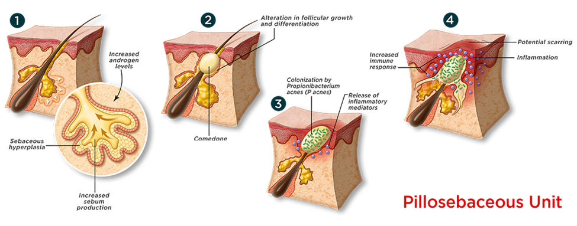
Acne pathophysiology
Ref: https://www.eternalskincare.ca/ESK-Blog/Acne-and-Blemishes

Slide 34
Epidemiology
Acne is the eighth most prevalent disease in the world affecting 10% of the world population¹
Affects approximately 85% of adolescents and young adults aged 12 to 25 years²
Prevalence of acne is higher in females than males
about 48–52% of facial acne patients also have truncal acne.³
1.Adelaide Hebert, MD; Diane Thiboutot, MD; Linda Stein Gold, MD; Martina Cartwright, PhD;Mara Gerloni, PhD; Enrico Fragasso, MS; Alessandro Mazzetti, MD: Ecacy and Safety of Topical Clascoterone Cream, 1%, for Treatment in Patients With Facial Acne, JAMA Dermatology June 2020 Volume 156, Number 6
2.Anna Hwee Sing Heng & Fook Tim Chew, Systematic review of the epidemiology of acne vulgaris, Scientic Reports (2020) 10:5754
3.Yu Ri Woo and Hei Sung Kim, Truncal Acne: An Overview, J. Clin. Med. 2022, 11, 3660

Slide 35
Contributing factors
Genetic predisposition
Diet-High glycemic diet
Cosmetics-Long term use of oil based cosmetics, Facial massage
Menstrual cycle
Psychological factor-Stress

Slide 36
Varieties of acne lesion
Acne vulgaris can be divided into
non- inflammatory (open and closed comedones)
and inflammatory (papules, pustules and nodules) lesions

Slide 37
Types of acne
Acne Conglobata
Occupational acne
Cosmetic acne
Drug-induced acne
Infantile acne
Late onset acne
Acne excoriee
Acne fulminans
Post-facial massage acne

Slide 38
Differential diagnosis
Rosacea
Perioral dermatitis
Folliculitis
Hidradenitis suppurativa

Slide 39
Management
General measures
Maintain local hygiene
Avoid high glycemic food
Reduce stress

Slide 40
Patient Evaluation
Key Elements in History
previous medications used
current products being used for acne
medical problems
other medications
use of cosmetics or hair pomades
recreational activities and occupation

Slide 41
Management
Acne vulgaris can be treated either topically or systemically.
Topical therapy
Systemic therapy

Slide 42
Topical Therapy
Anti Comedonal Agents
Topical Retinoids
Azelaic acid
Salicylic acid
Anti Inflammatory Agents
Benzoyl Peroxide
Topical antibiotics

Slide 43
Systemic therapy
Oral Antibiotics
Isotretinoin
Hormonal Therapy

Slide 44
Oral Antibiotics
Tetracycline
Doxycycline
Minocycline
Erythromycin

Slide 45
Hormonal Therapy
Oral contraceptives pill
Spironolactone

Slide 46
Challenges in the management of Acne vulguris
Benzoyl peroxide -> has an irritant effect on skin-> Poor adherence
Retionoids-> associated with adverse effects like local irritation, erythema and must be used with caution in females of childbearing age owing to known teratogenicity.
Topical and oral antibiotics->Raising antibiotic resistance leads to poor therapeutic outcome
Hormonal therapy->associated with a relative increase in certain cardiovascular risk factors & contraindicated in males and in pregnancy.

Slide 47
Role of androgen in acne pathogenesis
Androgens, especially DHT are shown to induce both sebaceous gland growth and increased sebum production.
Creates a nourishing medium in which anaerobic C. acnes bacteria can flourish.
Acne pathogenesis

Slide 48
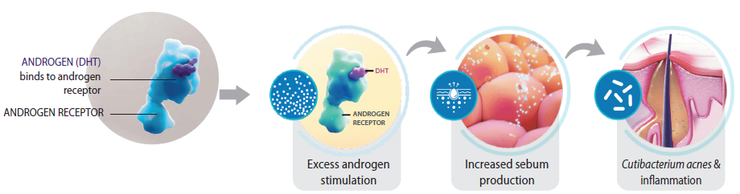
Androgen receptor pathway

Slide 49
Addressing Androgen pathway to treat Acne
Androgen inhibition is also an effective strategy for the treatment of acne.
Current anti-androgen drug therapies include
    oral contraceptives
    Spironolactone
    Flutamide
    Finasteride
However, their use can be associated with systemic adverse events and are unsuitable for use in males with acne.

Slide 50
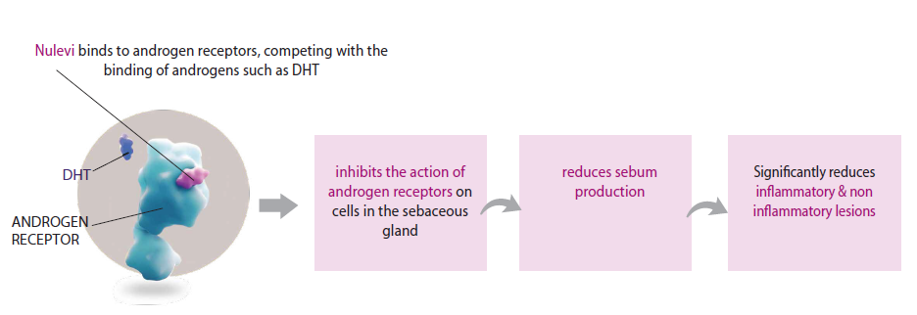
Clascoterone-A novel topical antiandrogen for acne vulgaris
Clascoterone 1% cream is a steroidal topical androgen receptor inhibitor which work through competitive inhibition of DHT receptors within the sebaceous glands and hair follicles
Adelaide Hebert, MD; Diane Thiboutot, MD; Linda Stein Gold, MD; Martina Cartwright, PhD;Mara Gerloni, PhD; Enrico Fragasso, MS; Alessandro Mazzetti, MD: Ecacy and Safety of Topical Clascoterone Cream, 1%, for Treatment in Patients With Facial Acne, JAMA Dermatology June 2020 Volume 156, Number 6
Notes:
Kindly add the literature pic.

Slide 51
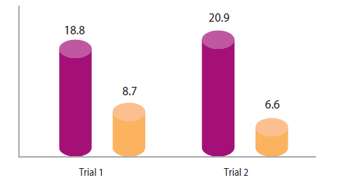
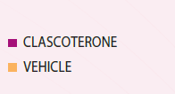
Clinical efficacy
In two identically-designed, multicenter, randomized, double-blind, vehicle-controlled clinical trials Clascoterone demonstrated significant reduction in facial & truncal acne in Investigator’s Global Assessment (IGA) Score from ≥2 to ≤1 in just 12 weeks.
M. H. GOLD, Clascoterone cream (1%) topical androgen receptor inhibitor for the treatment of acne in patients 12 years and older, EXPERT REVIEW OF CLINICAL IMMUNOLOGY 2021, VOL. 17, NO. 4, 301–308

Slide 52
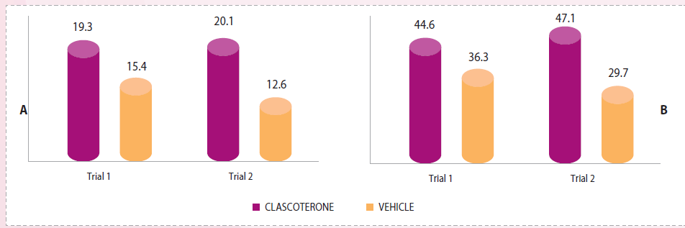
Clinical efficacy
Clascoterone was more effective than application of vehicle cream at achieving IGA success and reducing NILC and ILC in patients with facial acne vulgaris.
M. H. GOLD, Clascoterone cream (1%) topical androgen receptor inhibitor for the treatment of acne in patients 12 years and older, EXPERT REVIEW OF CLINICAL IMMUNOLOGY 2021, VOL. 17, NO. 4, 301–308

Slide 53
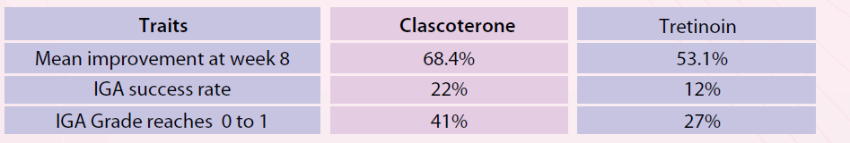
Clinical efficacy
Topical clascoterone was clinically superior to topical tretinoin for treating mild-to-moderate acne vulgaris.
M. H. GOLD, Clascoterone cream (1%) topical androgen receptor inhibitor for the treatment of acne in patients 12 years and older, EXPERT REVIEW OF CLINICAL IMMUNOLOGY 2021, VOL. 17, NO. 4, 301–308

Slide 54
Conclusion
Acne vulgaris is an inflammatory skin condition that typically affects teens and adolescents, although it can expand to affect other age groups.
There are several pathophysiologic pathways in the emergence of acne vulgaris. These pathways involve follicular hyper keratinization, overactive sebaceous glands, Cutibacterium acnes colonization, and inflammation. Therefore, the role of current acne treatments is to target these specific pathogenic factors.
At present, there are many topical treatments for acne available, including benzoyl peroxide (BPO), antibiotics, retinoids, dapsone, azelaic acid, and sulfur; however, patients often do not get a good response with these agents, and having better treatment options would be beneficial.
Androgens are hormones that regulate sebum production and play a key role in acne pathogenesis, contributing to symptom onset and persistence.

Slide 55
Conclusion
Antiandrogens can be effective for acne when given systemically. Spironolactone, a moderate androgen receptor blocker, has been used off-label, and oral contraceptives have been Food and Drug Administration approved for the use of acne. However, these agents are limited for use in women, and have systemic adverse effects.
Clascoterone 1% cream is a novel topical antiandrogen medication indicated for patients with acne vulgaris (both female and male) who are 12 years of age or older.
In clinical trials, at week 12, clascoterone met all three coprimary efficacy end points: proportion of patients achieving treatment success, absolute change from baseline in non-inflammatory lesion count (NILC), and absolute change from baseline in inflammatory lesion count (ILC).
The safety and efficacy of clascoterone for the treatment of acne has been demonstrated in numerous preclinical and clinical trials. Most common adverse events were local skin reactions but systemic adverse reactions were insignificant.
Clascoterone 1% cream is a novel first-in-class topical androgen receptor inhibitor for the treatment of acne vulgaris and represents the first new mechanism of action for acne treatment in almost 40 years and is an excellent antiandrogen therapy for topical use.

